Slide 1

Big Mountain Resort Ticket Prices

Slide 2
Problem Identification
Big Mountain Resort recently installed a new chairlift to increase visitor distribution across the mountain
The install raised operating costs by $1,540,000 this season
Resort has decided to raise ticket prices
The resort currently decides ticket prices by adding a premium above the average price of other resorts in their market segment
Big Mountain needs to reevaluate their ticket prices to better capitalize on their resort’s facilities

Slide 3
Recommendation and Key Findings
Big Mountain currently charges $81 for adult tickets. Our model showed that the resort could charge $95.87, a $14.87 increase.
Based on an expected 350,000 visitors with an average stay of 5 days, this would bring in an extra $26,022,500 per season.
This covers raised operating costs from the new chairlift.
More accurately reflects the resort’s standing in its market segment.

Slide 4
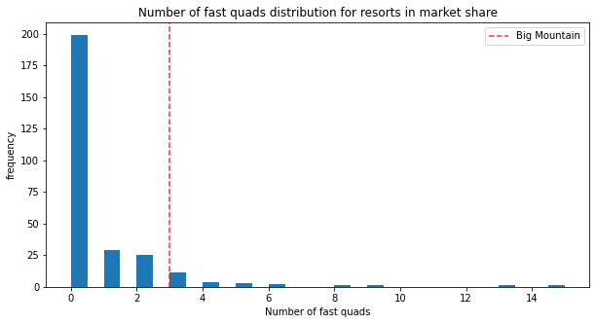
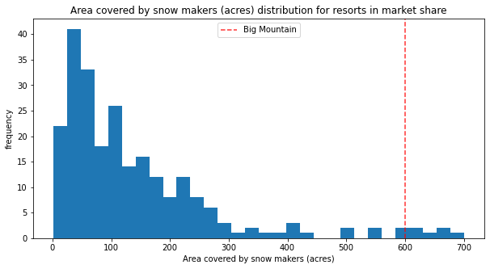
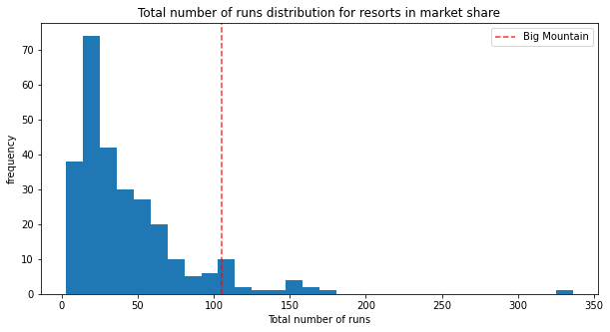
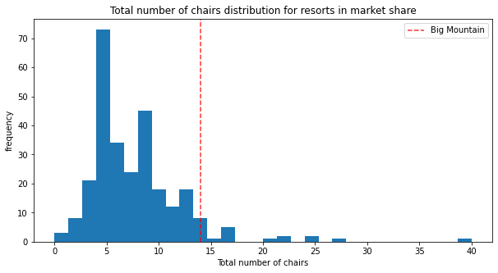
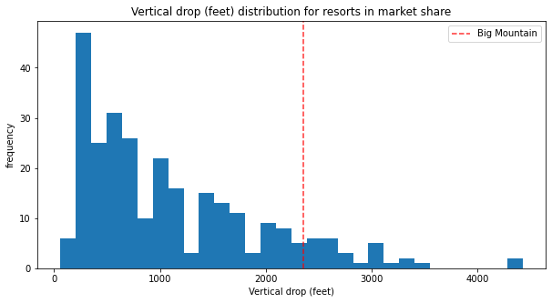
Modeling Results and Analysis
Our model showed that the most impactful features to ticket price included vertical drop, snow making acres, total chairs, number of runs and fast quads.
Big Mountain ranks very high in the features shown in the plots to the right
Notes:
How large the plots are is not important. The audience just needs to see how big mountain is consistently in the top of these important features.

Slide 5
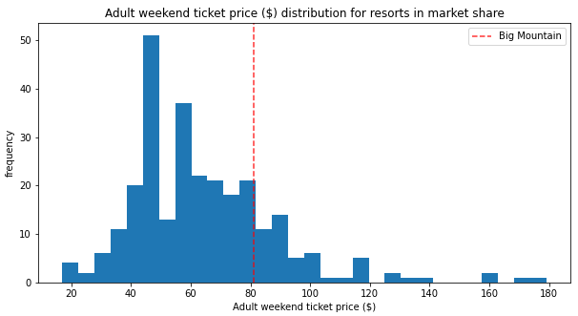
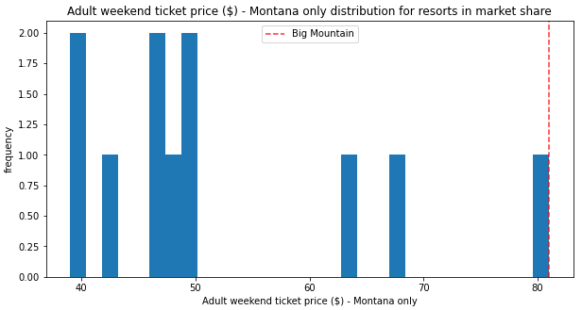
Modeling Results and Analysis
When you look at ticket prices, Big Mountain is not ranked as highly as its important features suggest it should
This could be from comparing the resorts prices to other resorts in Montana, which have lower ticket prices that could be artificially lowering Big Mountain’s
Analysis showed that state does not have an impact on ticket prices
The resort should instead capitalize on its features compared to resorts nationwide

Slide 6
Modeling Results and Analysis
The resort has been looking at different scenarios for cutting costs or increasing revenue from ticket prices.
Of the four scenarios given to us, the second one is recommended.
This scenario would add a run, increase vertical drop by 150ft and install an additional chair lift.
These changes would increase ticket price by $1.99 each
Season revenue increased by $3,482,500
Further work: this recommendation should be balanced against the costs associated with the changes above

Slide 7
Conclusion
Big Mountain’s current strategy was under valuing their tickets.
A price increase of $14.87 a ticket would more accurately reflect their place in the market.
The resort now has a model that they can use to look at different scenarios for cutting costs or increasing ticket prices based on resort features.

